Slide 1
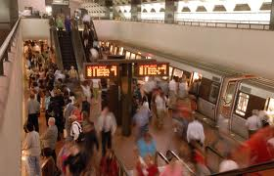
Literature Review on Train Scheduling for minimizing passenger waiting time
Kan Wu
Reference:
Train scheduling for minimizing passenger waiting time with time-dependent demand and skip-stop patterns: Nonlinear integer programming models with linear constraints
-Huimin Niu, Xuesong zhou, Ruhu Gao

Slide 2
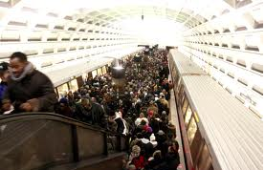
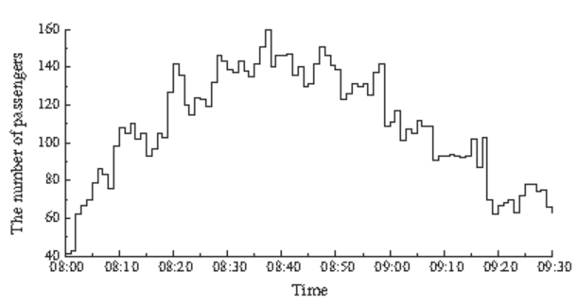
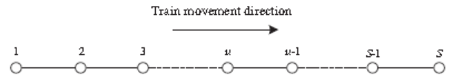
Introduction & Problem Statement
One direction and Single Track
Provided Train capacity >=total demand
No oversaturation situation
Time-dependent demand [0,T]: passenger come during a minute interval-PAX/min
Demand-responsive timetable
Source: Huimin Niu et.al (2015)
Hourly demand data
Minute demand data

Slide 3
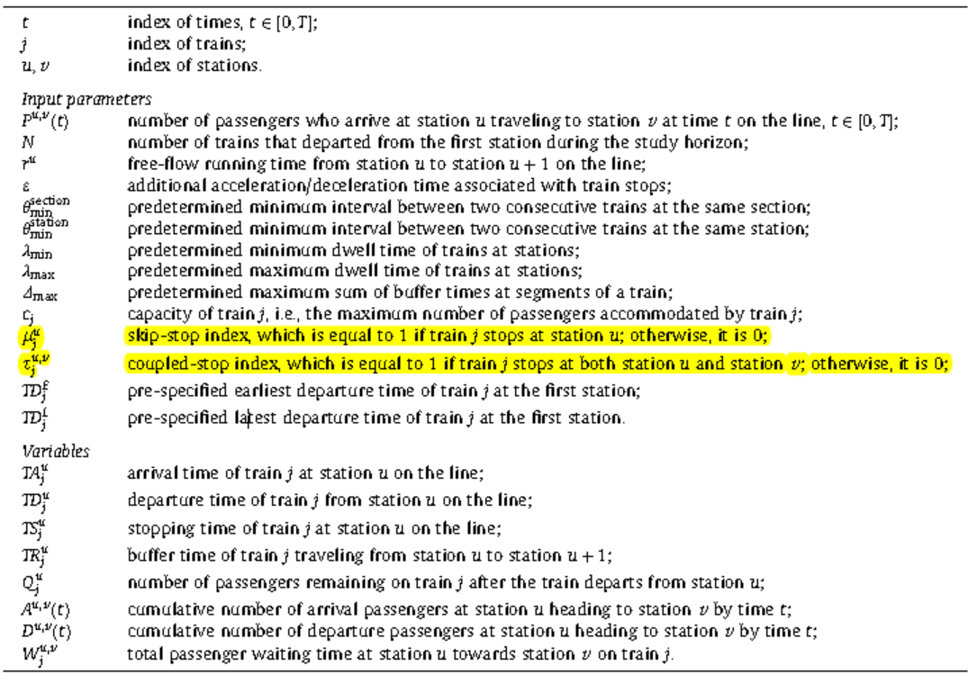
Notations Source: Huimin Niu et.al (2015)

Slide 4
Quick Review: Cumulative Flow Count Diagram
A(t) = cumulative arrivals from time 0 to time t
D(t) = cumulative departures from the system from time 0 to time t
L(t) = number of customers waiting in the system at any time t
= A(t) – D(t)
Source: Quadratic Programming Model for Optimizing Demand-responsive Transit Timetables -by Huimin Niu and Xuesong Zhou

Slide 5
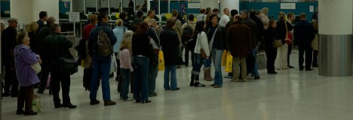
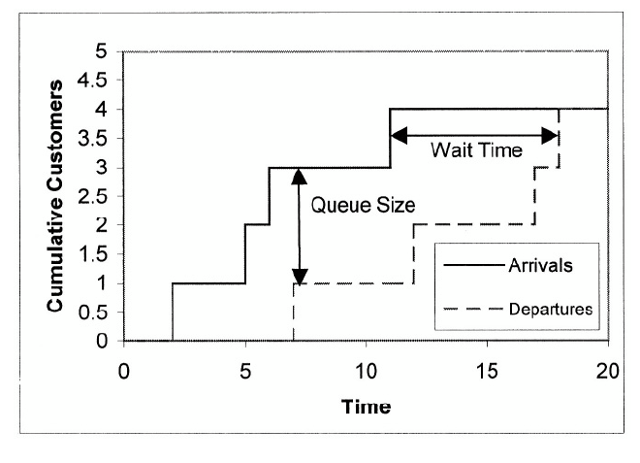
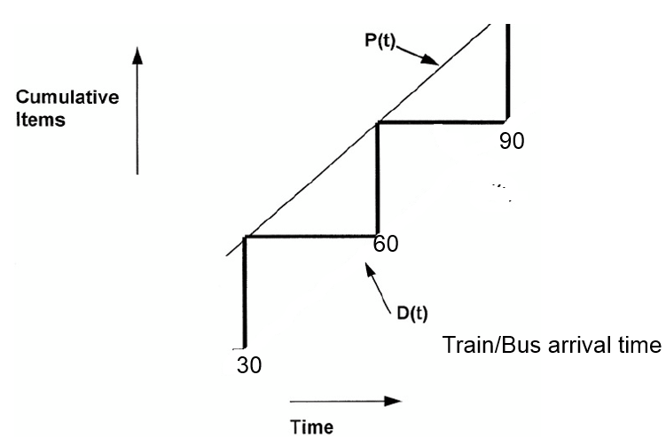
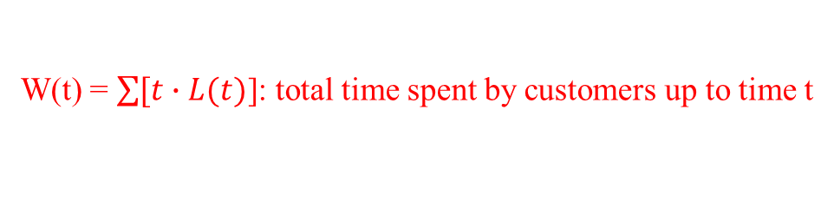
Illustration: Bulk Queue: Constant Arrival/Batch Departure
W(t) = $\sum{[t∙L(t)}$]: total time spent by customers up to time t
Source: Quadratic Programming Model for Optimizing Demand-responsive Transit Timetables -by Huimin Niu and Xuesong Zhou

Slide 6
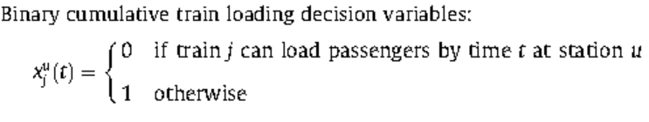
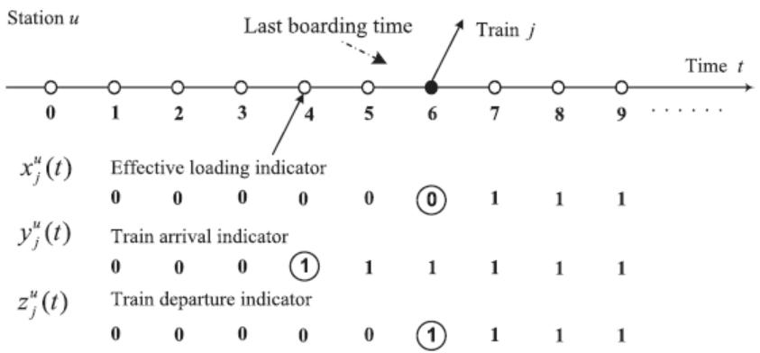
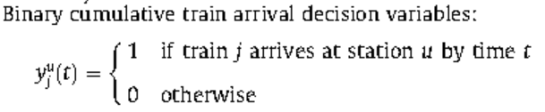
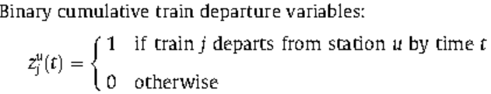
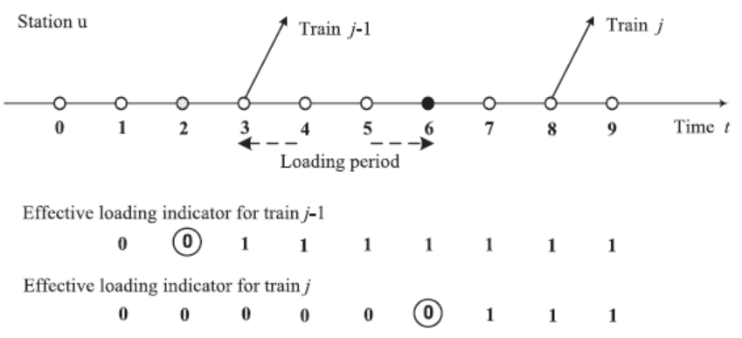

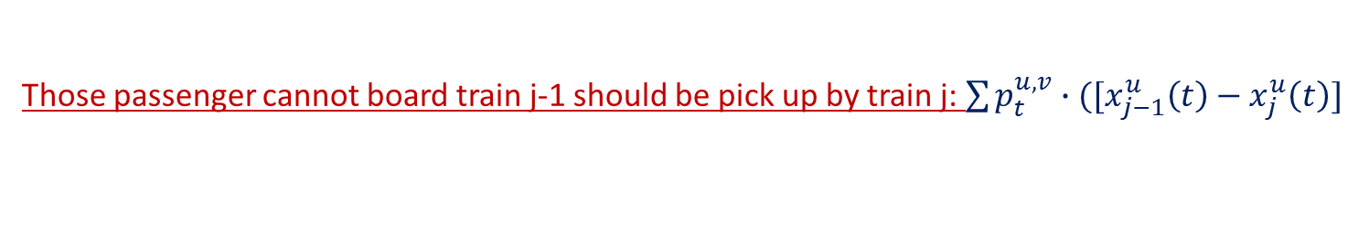
Recap/overview of previous paper REF: Huimin Niu et.al (2015)
Oversaturation permitted in previous paper
Those passenger cannot board train j-1 should be pick up by train j: $\sum{p_{t}^{u,v}∙([x_{j−1}^{u}\left(t\right)−x_{j}^{u}\left(t\right)]}$
Unloading period for train j-1

Slide 7
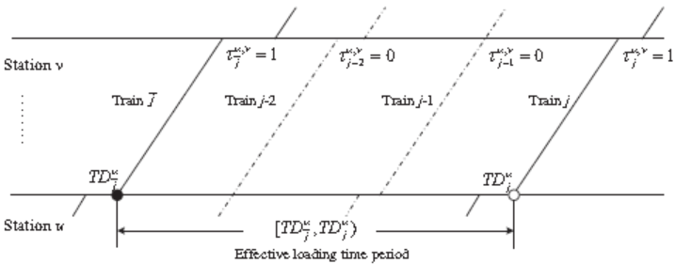
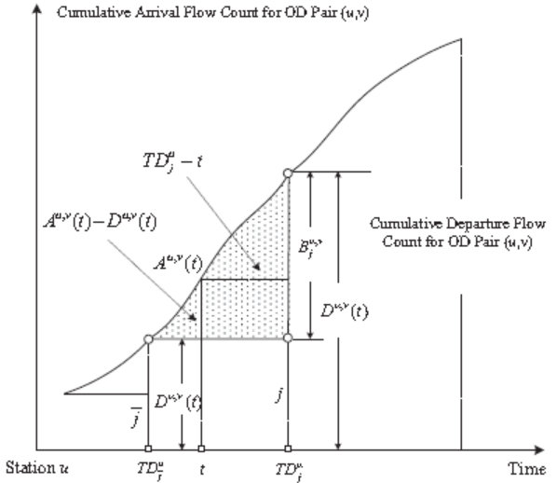
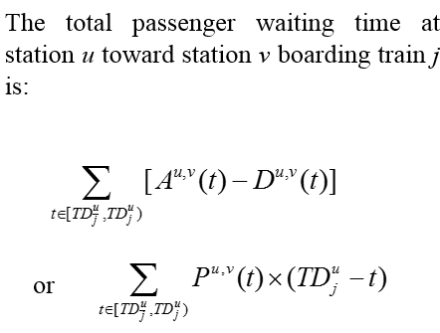
Dummy train-$\overline{j}$ that has the same couple-stop pattern with train-j to cover the OD pair (u,v)
Source: Huimin Niu et.al (2015)

Slide 8
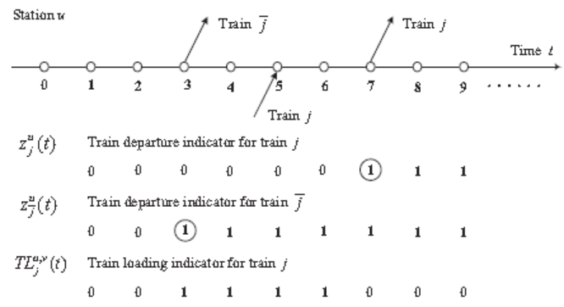


Effective loading time
No oversaturation situation
${TL}_{j}^{u,v}=z_{\overline{j}}^{u}\left(t\right)−z_{j}^{u}$(t)
Source: Huimin Niu et.al (2015)

Slide 9

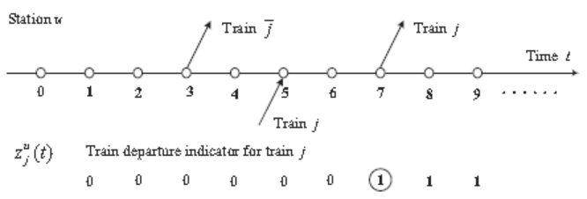

Define the departure time at station u
$z_{j}^{u}\left(t−1\right) 0 0 0 0 0 0 0 1 1$
Objective function for high-resolution demand model (minute)
Effective load# (train j is available for those who from u to v )
Constraints
Train capacity
Linking constraints (relationship between arrival time and departure time for train j and j-1)
Safety headway
Feasible range constraints (stopping time, buffer time)
Departure time from first station

Slide 10
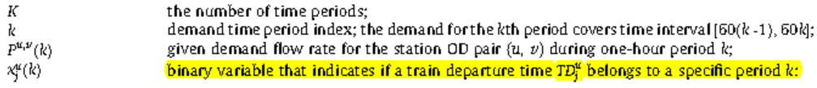
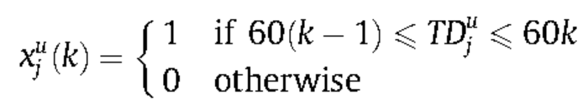
Low resolution demand model-passenger arrive at a constant for a given hourly period
t/min
Scenario-1
Time-k(hour)
60(K-1)
60k
Scenario-2
60(K-2)
60(K-1)
60k

Slide 11
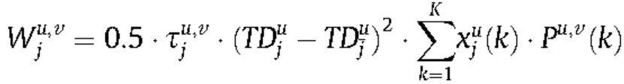
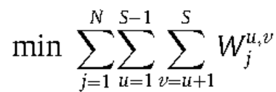
Low resolution demand model-objective function: minimize total waiting time for all passengers
Scenario-1
Scenario-2
Total Waiting time for OD (u,v)
t/min
Objective function
Scenario-1
Time-k(hour)
60(K-1)
60k
Scenario-2
60(K-2)
60(K-1)
60k

Slide 12

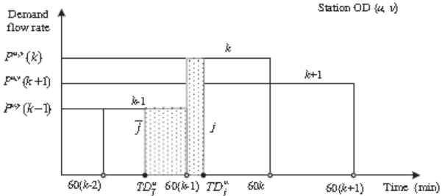
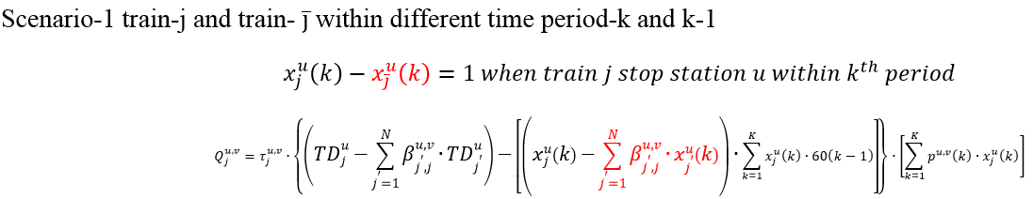
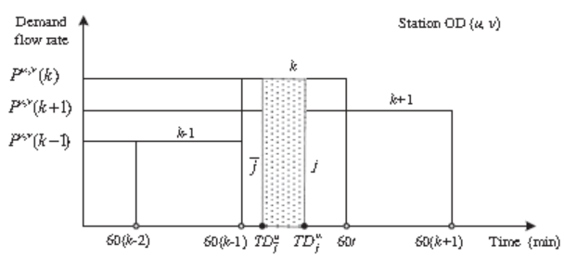
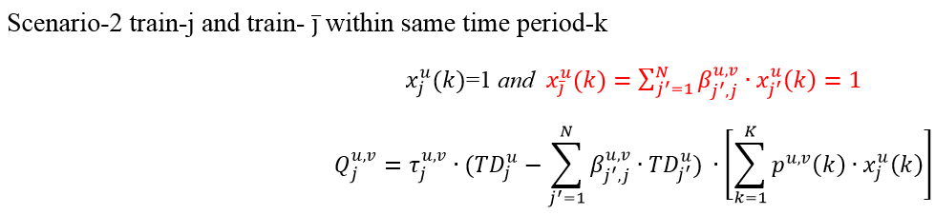

Train capacity constraints setup
Scenario-2
Scenario-1
Scenario-2

Slide 13
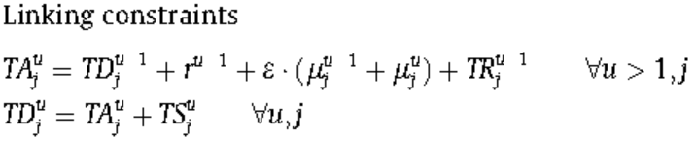
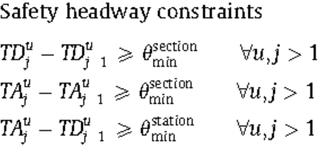
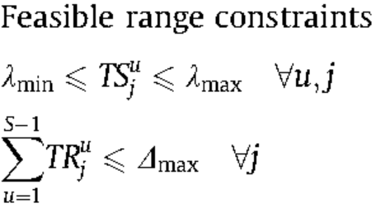
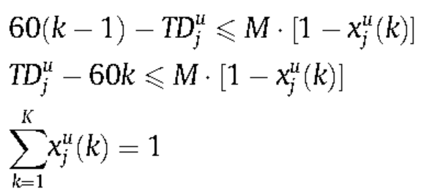

Other Constraints
Earliest and latest departure time from first station

Slide 14
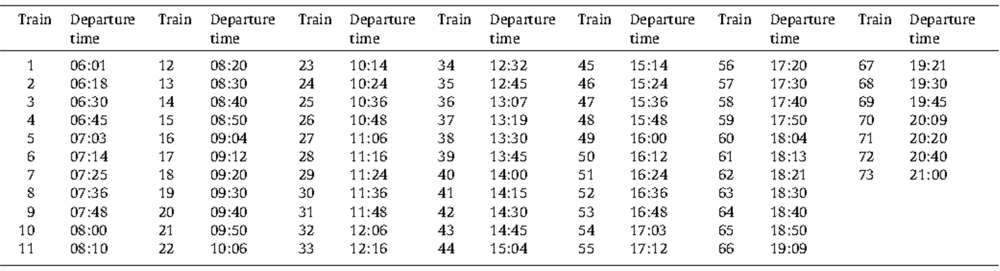
Example: optimized departure time at first station for 73 trains
Source: Huimin Niu et.al (2015)

Slide 15
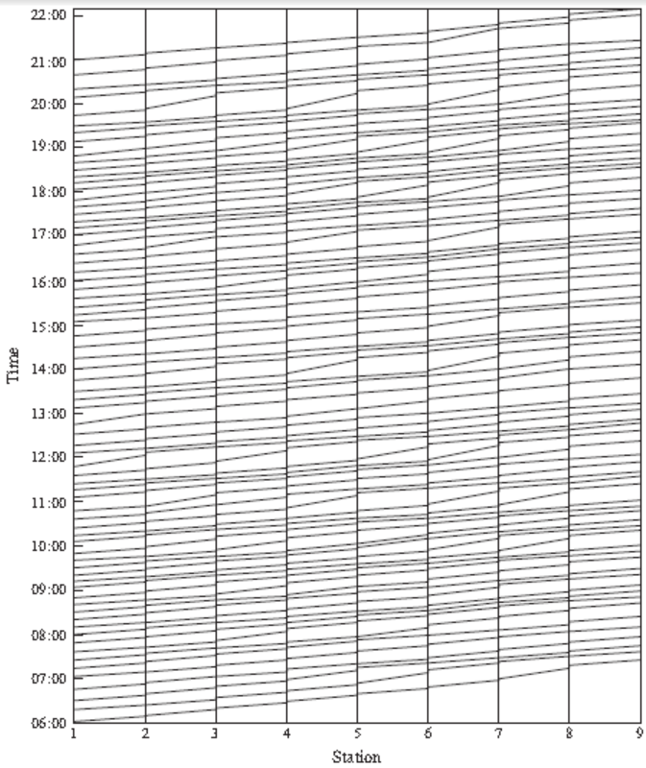
The optimized train timetable from 6:00 to 21:00 over the daily operational horizon.
Source: Huimin Niu et.al (2015)

Slide 16
Conclusions
Demand-oriented passenger train timetable optimization for a rail corridor under time-dependent demand conditions
A unified nonlinear integer programming model with linear constraints is developed for both high resolution and medium/low-resolution time-varying demand data
Source: Huimin Niu et.al (2015)

Slide 17
Thanks!
Questions?

